Slide 1
Chemistry in Everyday Life
Dr.V.S.Suryawanshi
Assosiate Professor of Chemistry
S.C.S.College,Omerga.

Slide 12
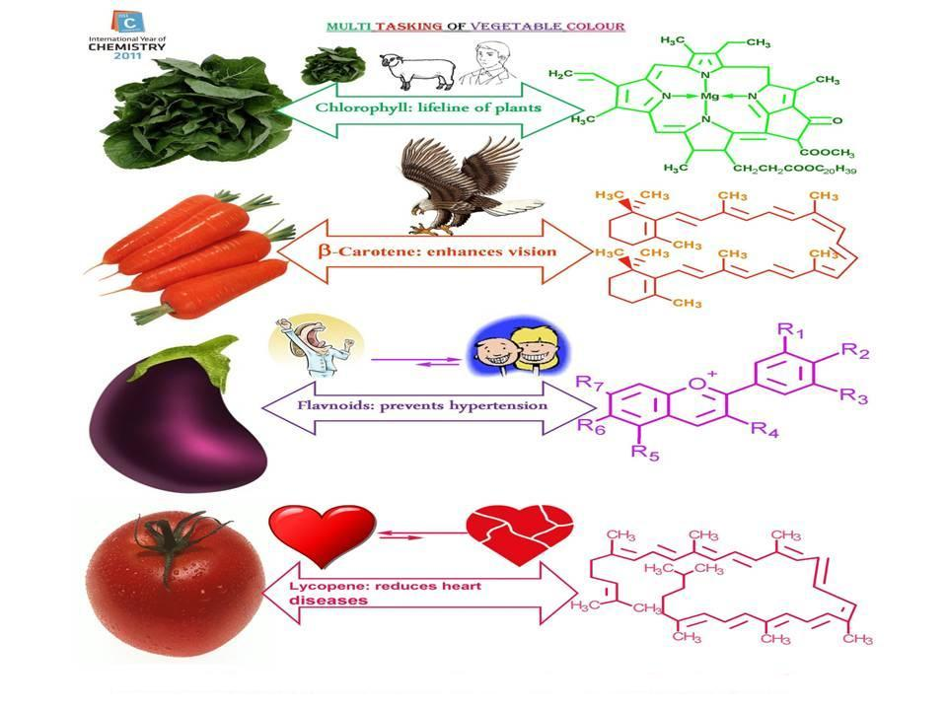

Slide 16
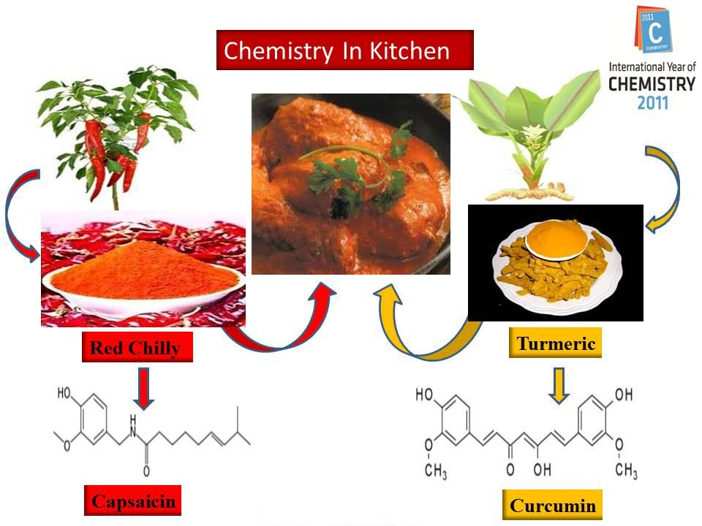

Slide 26
THANK YOU

